Slide 1
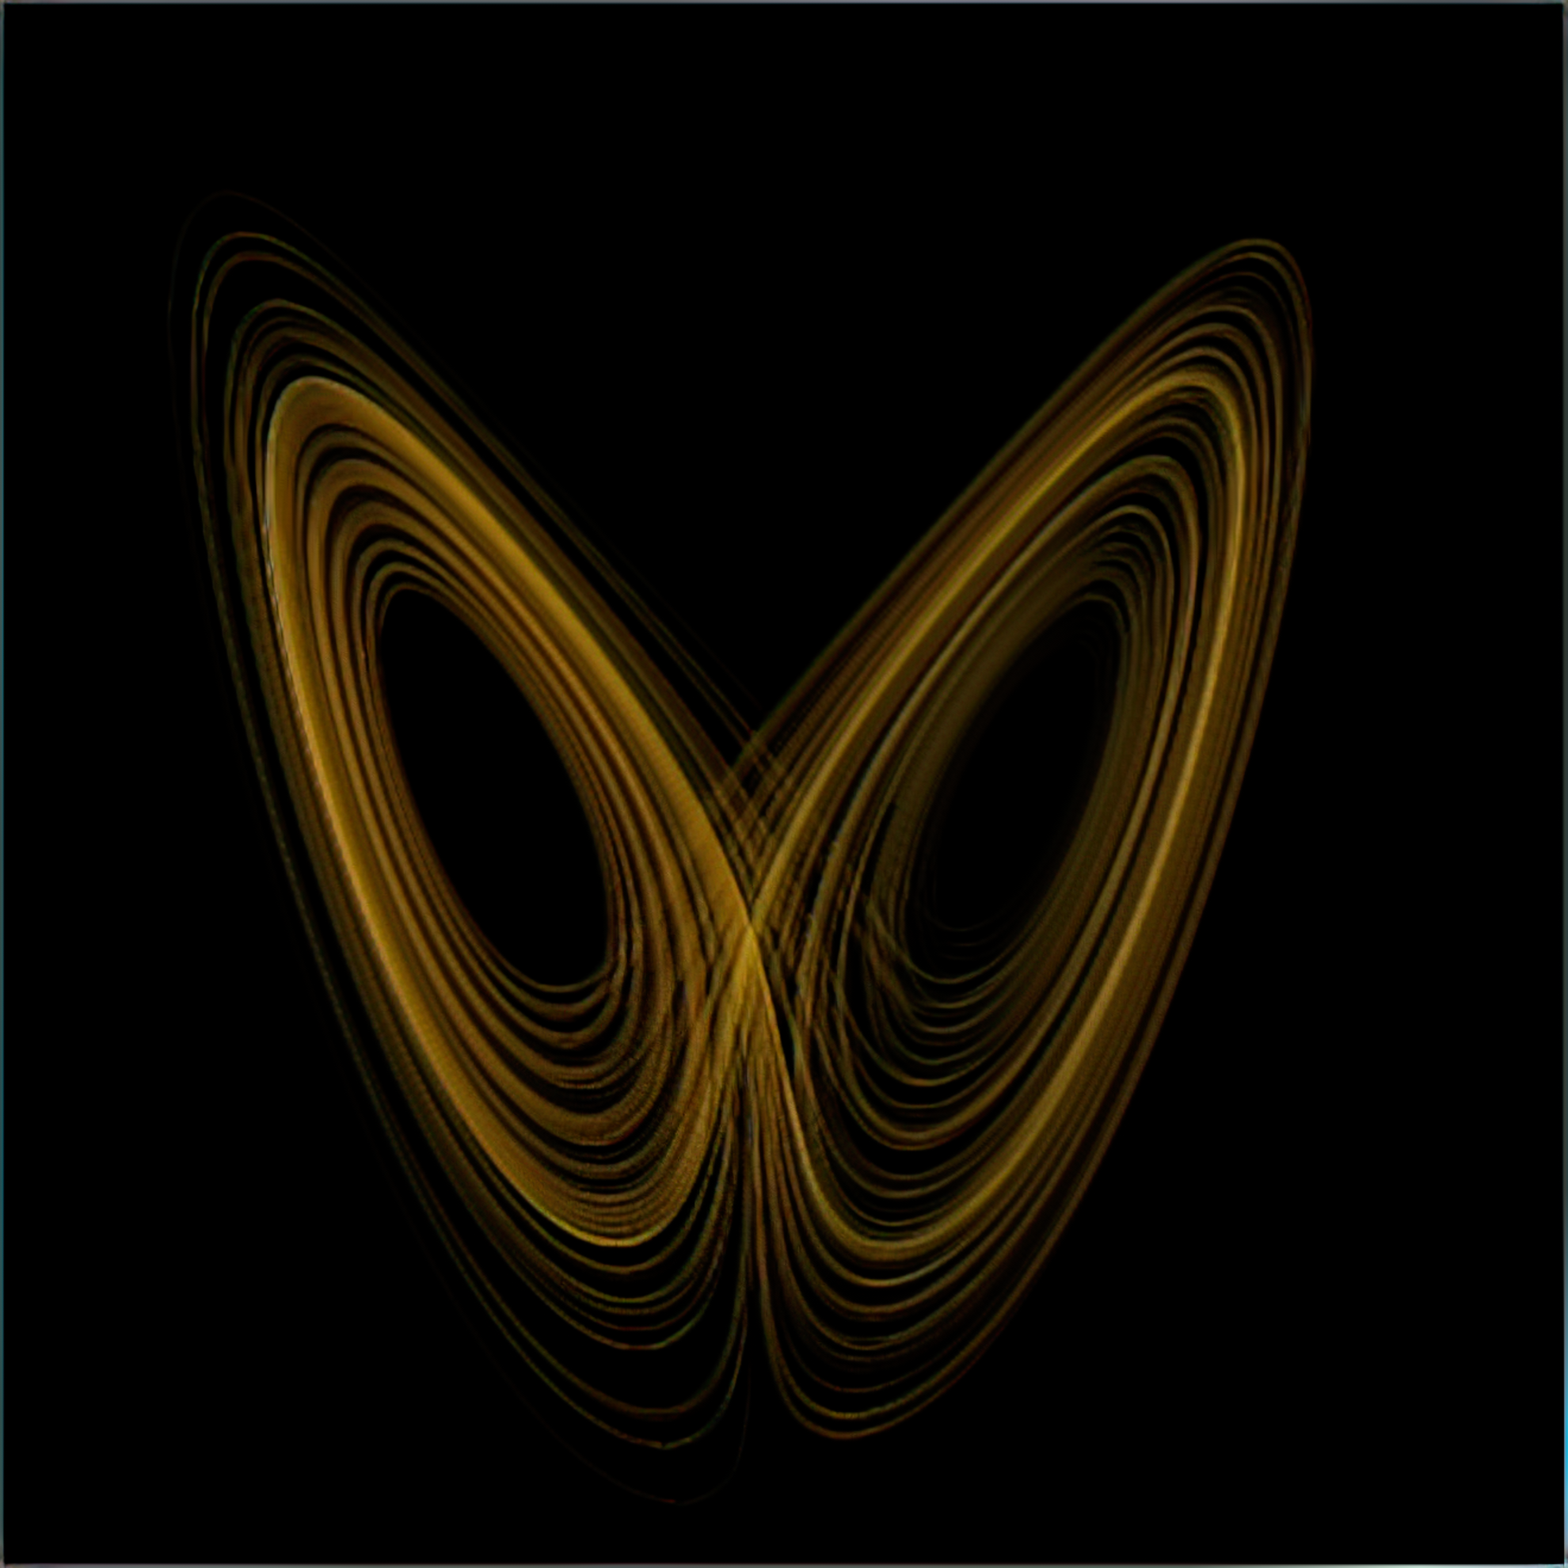
Chaotic Oscillators
By: Bodhi Broderick and Nicholas Proctor

Slide 2
Chaos Theory
“Predictable” Deterministic Systems that are:
Sensitive to initial conditions
Topologically transitive
Shifts between >1 end conditions
w/ dense periodic orbits

Slide 3
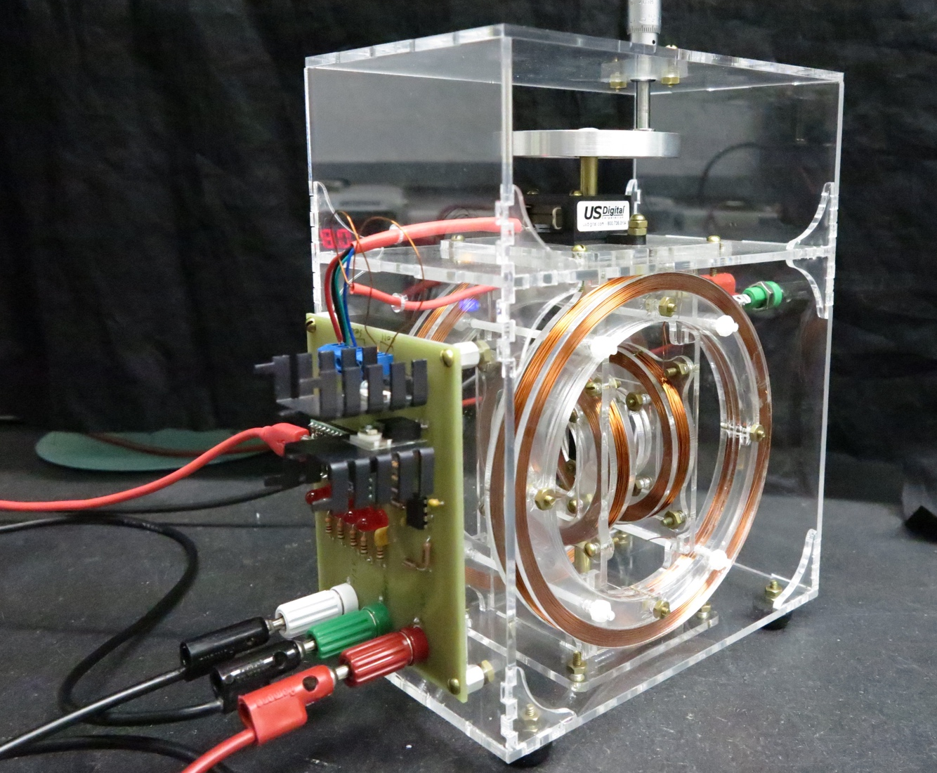
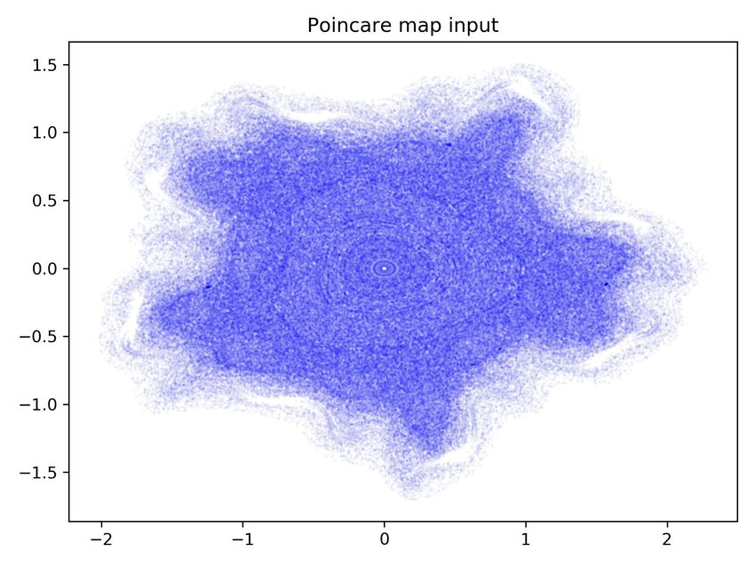
Mechanical Chaotic Oscillator
2 sets of coils => 2 Magnetic Fields
Large orients central magnet
Small toggled to create chaotic oscillation
Poincare map
Position vs Angular Velocity
Oscillating gravitational force

Slide 4
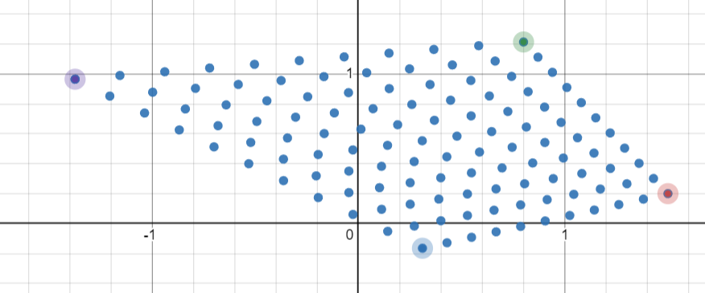
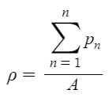
Data Mining
Collection
Raspberry Pi (microcontroller)
Aggression++ and stability++
Data Visualization
16 Million Data Points
Point Density
Trials
Frequency => Amplitude
Visualization over many trials

Slide 5
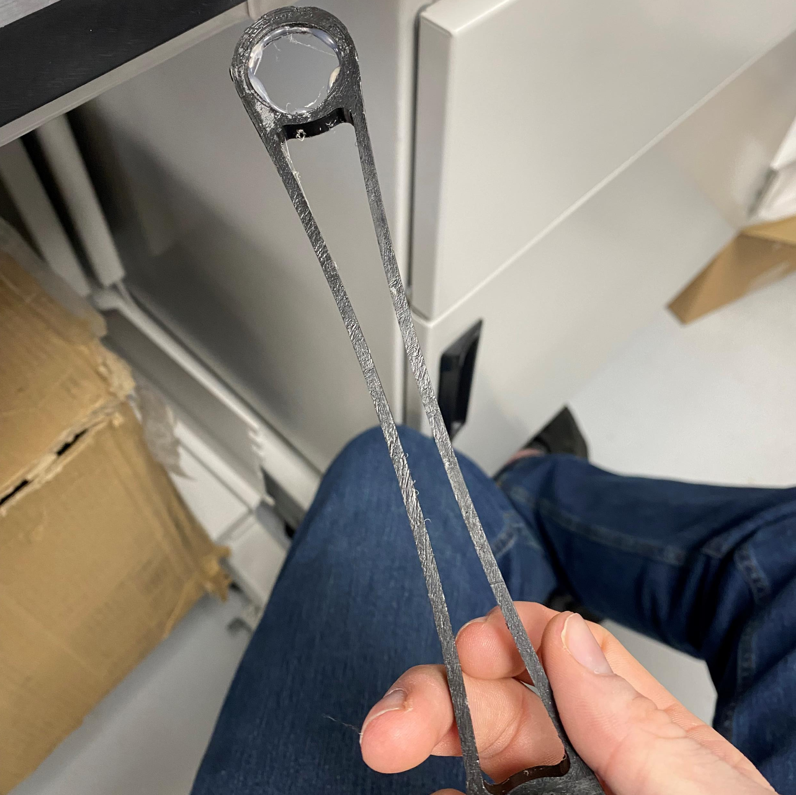
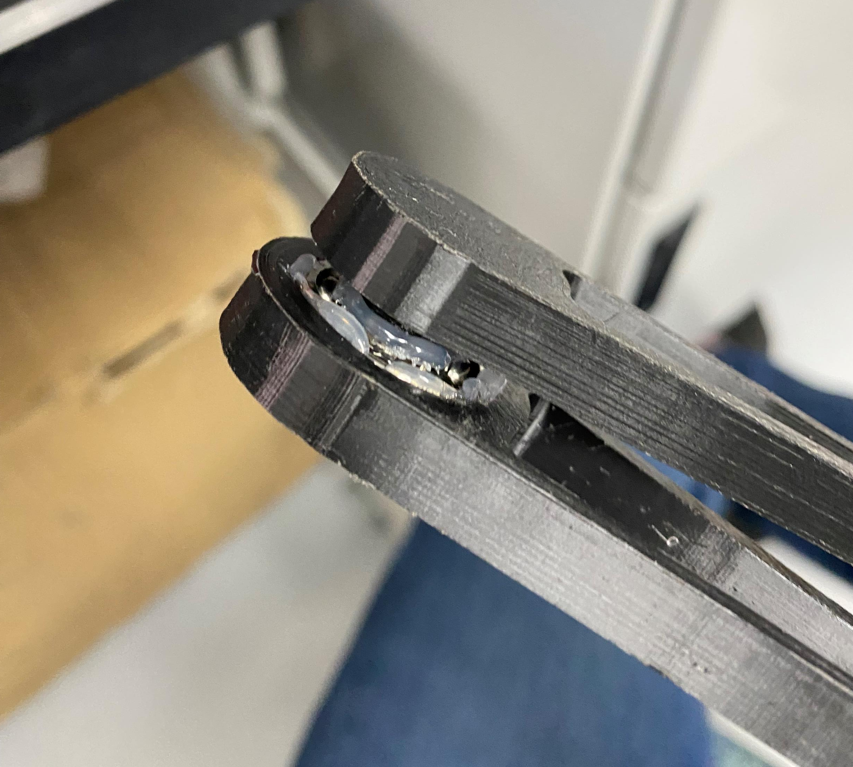
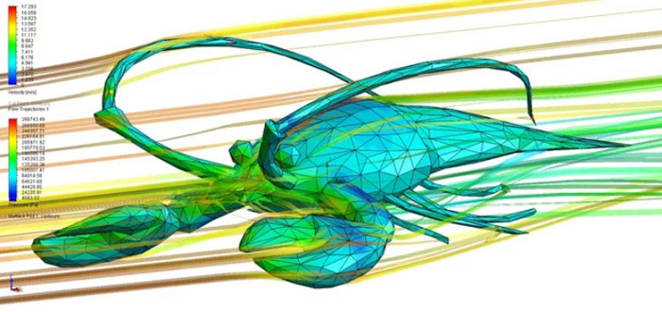



Double Pendulum
Joint Issues
Adhesive => epoxy
3D Printing
Milling
Chaotic => Energy Loss
Friction
Drag
CFD : simpleFoam

